Slide 1

BCA Ist Semester Introduction of Logic Circuit and Digital Design(ILCDD) Course Code: BCAC003
Presented by:
Mr.Anuj Kumar
Assistant Professor, Dept. Of CE&A
GLA University, Mathura

Slide 2

Encoder/Decoder
ENCODER- a digital circuit that produces a binary output code depending on which of its inputs are activated.
DECODER- a digital circuit that converts an input binary code into a single numeric output.
A₀ A₁ A₂ A₃ A₄ A₅ A₆ A₇
O₀ O₁ O₂
A₀ A₁ A₂
O₀ O₁ O₂ O₃ O₄ O₅ O₆ O₇
ENCODER
DECODER

Slide 3
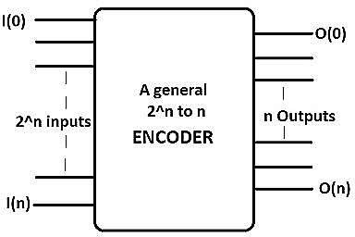
Encoders
Binary code of N digits can be used to store 2^{N} distinct elements of coded information.
Encoders convert 2^{N} lines of input into a code of N
bits and

Slide 4
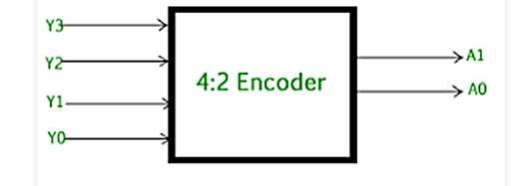
Encoder Example
Example: 4-to-2 binary encoder
In encoder circuit only one input may be set high (1) at a
certain time.
The output is a 2-bit number.
I₀
I
I₃ | I₂ | I₁ | I₀ | Y₁ | Y₀
0 | 0 | 0 | 1 | 0 | 0
0 | 0 | 1 | 0 | 0 | 1
0 | 1 | 0 | 0 | 1 | 0
1 | 0 | 0 | 0 | 1 | 1
1
Y₁
I₂
I₃
Y₀

Slide 5
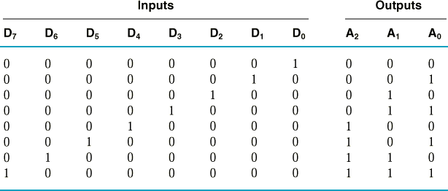
Encoder Example
Example: 8-to-3 binary encoder (octal-to-binary)
A₀ | = | D₁ | + | D₃ | + | D₅ | + | D₇
A₁ | = | D₂ | + | D₃ | + | D₆ | + | D₇
A₂ | = | D₄ | + | D₅ | + | D₆ | + | D₇

Slide 6
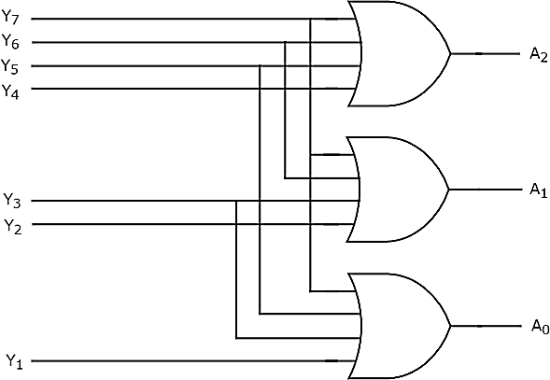
Encoder Example (cont.)

Slide 7
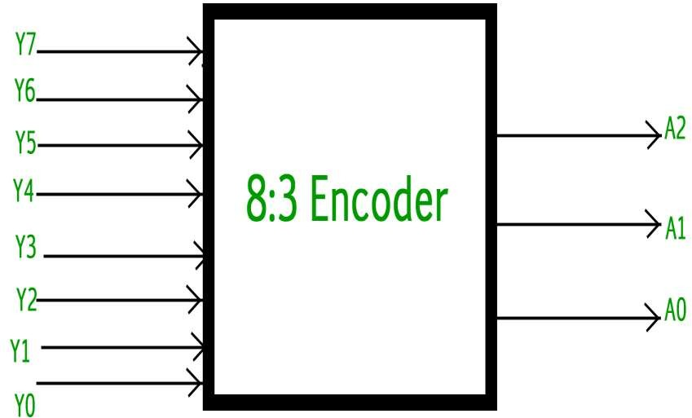

Slide 8
Decoders

Slide 9
Binary Decoders
Binary decoders convert an n-bit input to a single output. It uses its n-bit input to determine which of the 2^{n} outputs will be uniquely activated.
The outputs of a decoder are minterms. That is why decoders are sometimes called as minterm generators.
We can easily use a decoder to implement any sum of minterms expression.
Note: A minterm is a Boolean expression resulting in 1 only for the output of a single row (in a truth table) or a single cell (in a Karnaugh map), and 0s for all other row or cells, respectively.

Slide 10
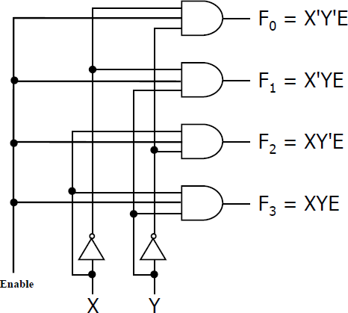
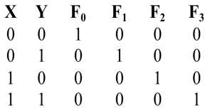
2-to-4 Binary Decoder
A circuit of 2-to-4 binary decoder is shown below.
Binary Decoder
2 inputs
4 outputs
Enable
The truth table shows that for any given input combination,
exactly one output will turn to 1.
The enable must be set to 1 to get an output.

Slide 11
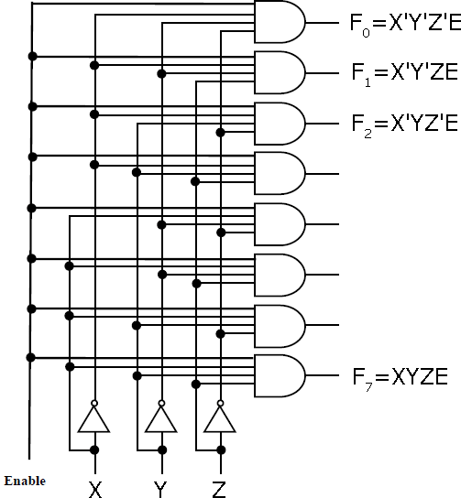
3-to-8 Binary Decoder
Try to understand the logic circuit of 3-to-8 binary decoder below.
X | Y | Z | F | F | F | F | F | F | F | F₇
0 | 0 | 0 | 1 | 0 | 0 | 0 | 0 | 0 | 0 | 0
0 | 0 | 1 | 0 | 1 | 0 | 0 | 0 | 0 | 0 | 0
0 | 1 | 0 | 0 | 0 | 1 | 0 | 0 | 0 | 0 | 0
0 | 1 | 1 | 0 | 0 | 0 | 1 | 0 | 0 | 0 | 0
1 | 0 | 0 | 0 | 0 | 0 | 0 | 1 | 0 | 0 | 0
1 | 0 | 1 | 0 | 0 | 0 | 0 | 0 | 1 | 0 | 0
1 | 1 | 0 | 0 | 0 | 0 | 0 | 0 | 0 | 1 | 0
1 | 1 | 1 | 0 | 0 | 0 | 0 | 0 | 0 | 0 | 1
0
1
2
3
4
5
6
Binary Decoder
3 inputs
8 outputs
Enable

Slide 12
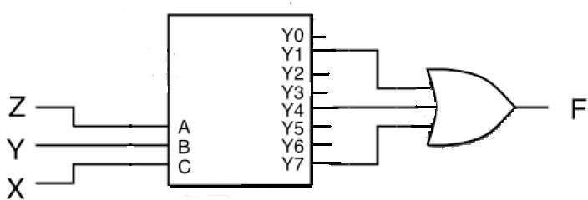
Combinational Circuit Design with Decoders
Example Realize F (X,Y,Z) = Σ (1, 4, 7) with a decoder:

Slide 13
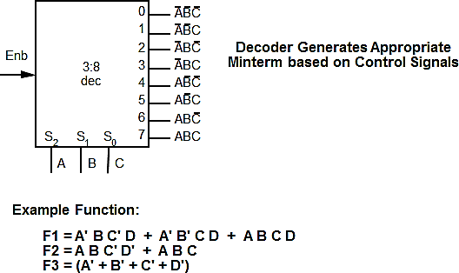
Decoder as a Logic Building Block

Slide 14
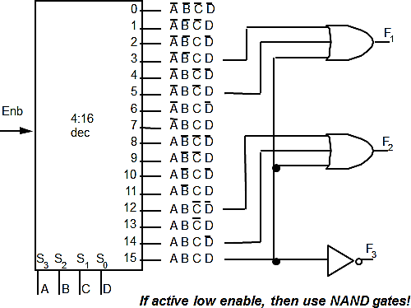
Decoder as a Logic Building Block

